Slide 1
Data Driven Decision Making using Data Science and Analytics
Stephen Opiyo
Presentation to Nairobi Women in Machine Learning and Data Science
May 26th, 2018

Slide 2
Overview
Introduction
- Data Science
- Analytics
Data Science and Analytics Projects
Questions

Slide 3
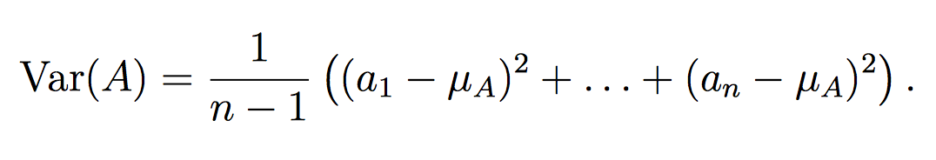
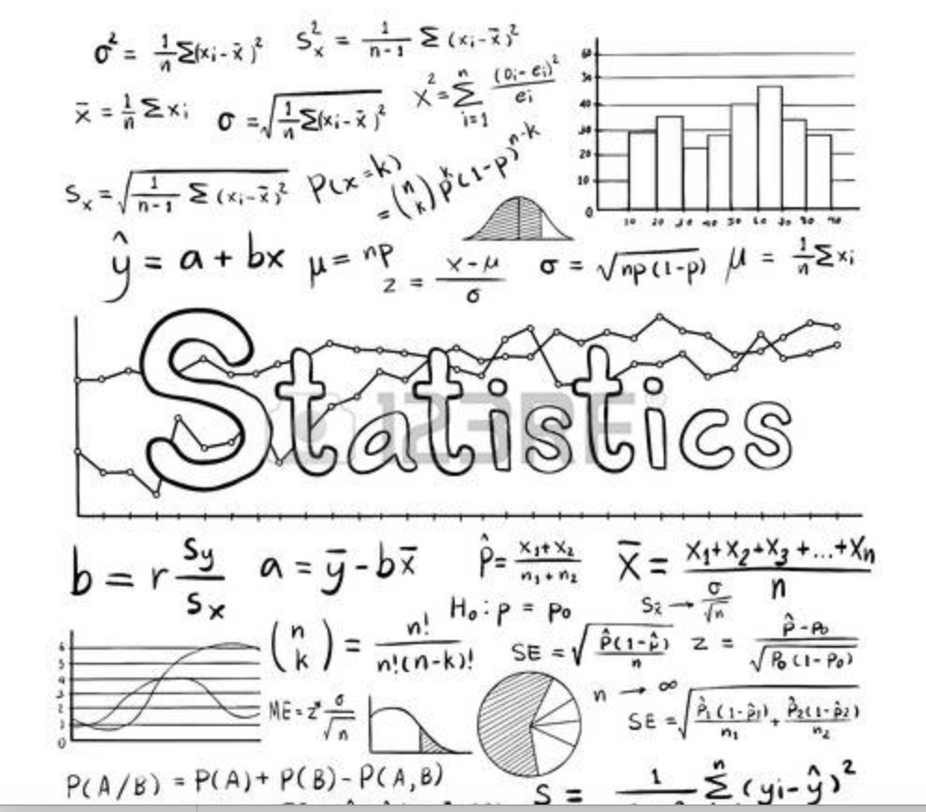
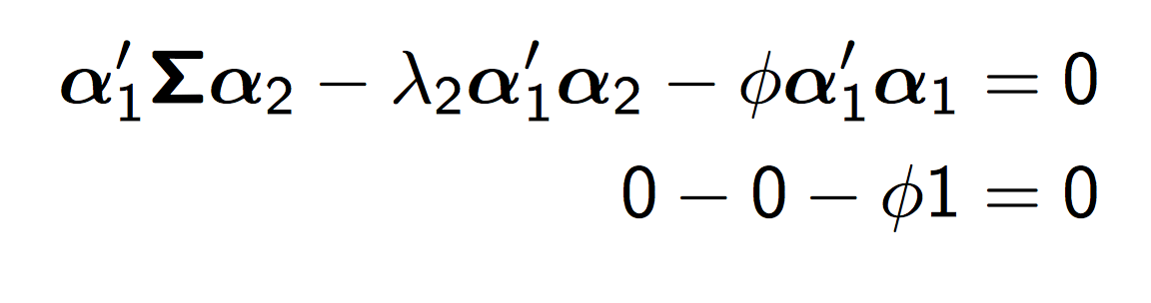
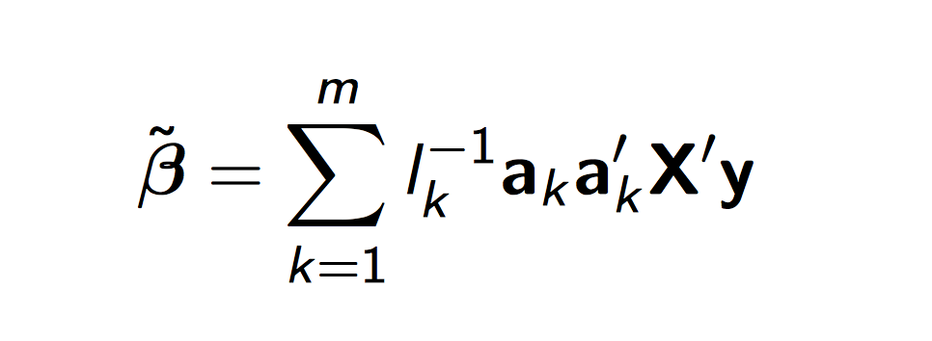
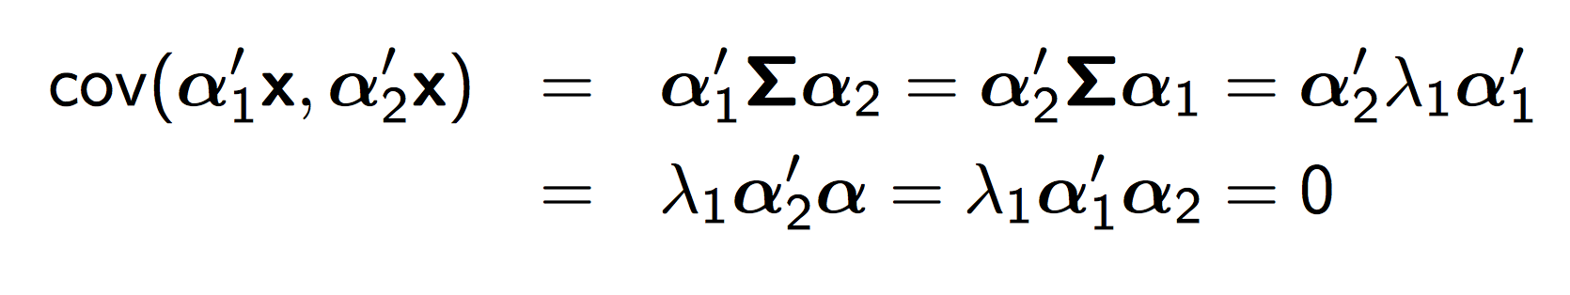
What is Data Science?

Slide 4
What is Data Science?
Data - driven science
Interdisciplinary field of discovering knowledge/insights from data
Quantitative/qualitative science, information technology, business and communications
Analytics is the engine of Data Science

Slide 5
What is Analytics?
Analytics allow us to derive value from data by answering four key questions:
What happened?
Why did it happen?
What’s is happening now?
What might happen in the future?

Slide 6
What is Analytics?
Analytics is a process by which you take raw material (data) and convert it into relevant insights that can inform organization, improve performance and guide strategy.

Slide 7
Types
Descriptive analytics: Describing what happened (What is the problem). It does not employ statistical algorithms.
Diagnostics analytics: Diagnosing what is wrong
Predictive analytics: Predicting what is ahead by using collected data to train models that will predict what is in the future.
Prescriptive analytics: anticipates what will happen and what should be done to benefit from the predictions.

Slide 8
The raw material of analytics - Data
In general, data is any set of characters that has been gathered and translated for some purpose, usually analysis. It can be any character, including text and numbers, pictures, sound, or video.
Data contains variables (key performance indicators)
Examples of variables: Age, income, education, etc.

Slide 9
Type of data: Structured
Structured data is highly organized and located in a fixed field within a defined record or file.

Slide 10

Types of data: Unstructured
Unstructured data is everything else that can’t be easily inserted into fields, rows or columns. It is often text heavy may contain dates, numbers, different types of data such as images.

Slide 11
Type of data: Semi-structured
Semi-structured data is a hybrid of unstructured and structured data.

Slide 12
Source of data
Internal data source and external data source.
Internal data source is owned and controlled by the organizations.
As a rule of thumb, internal data is usually easier and cheaper to access because it is controlled by the organizations. They might include claim history, financial records, customer feedback, transaction history, employee , etc.

Slide 13
Source of data
External data is any data that exists outside the organizations which is held either publicly or privately by another organization.
External data might include weather data, social media profile data, trend data or government-held data such as census information.

Slide 14
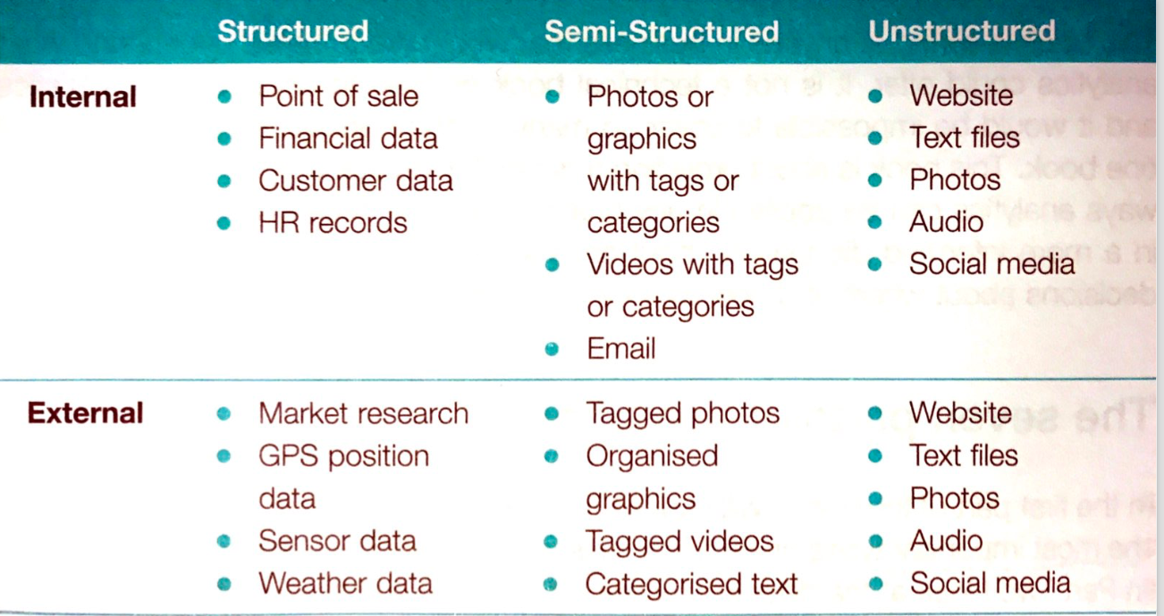
Source and type of data

Slide 15
Overview
Introduction
- Data Science
- Analytics
Data Science and Analytics Projects
Questions

Slide 16
Insights from Insurance Data From Kenya
Organization question | Raw material (Data) | Data source | Data type
Can we reduce lapse Rate of lapse is 36%? | Yes | Internal | Semi-structured
Format: Excel
Data type: Semi-structured
Data source: Internal
Observations: 53,776
Variables: 22

Slide 17
Sample data

Slide 18
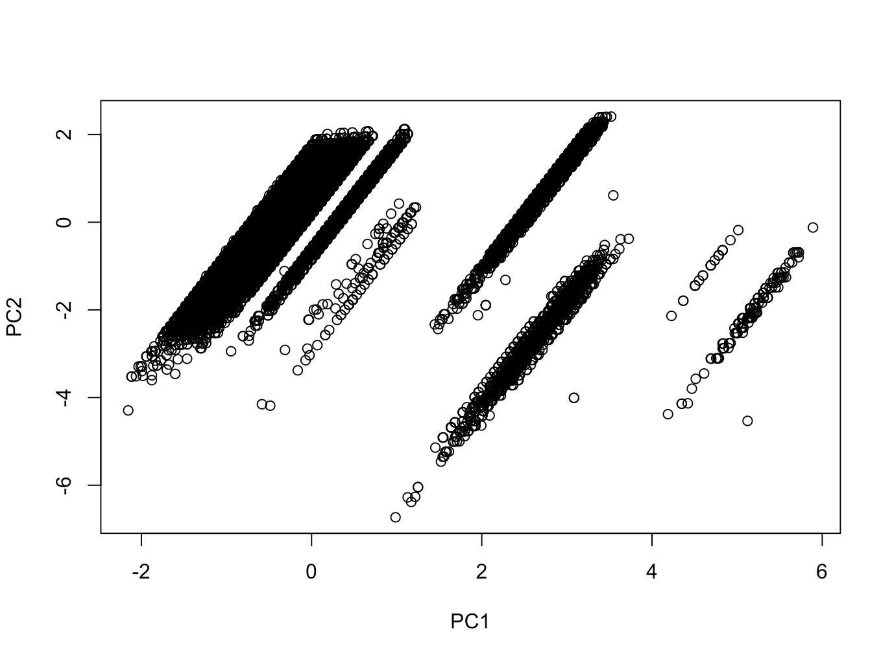
PCA of agents
Group 6
Group 3
Group 5
Group 2
Group 4
Group 1

Slide 19
Groups
Average of variables for each group
Group 1: Agent = 1 policy (540)
Group 2: Agent = 2 (287)
Group 3: Agent = 3 -19 (845)
Group 4: Agent = 20 – 100 (329)
Group 5: Agent = 101 -296 (329)
Group 6: Agent = 300 -680 (14)
Group | Age | Term | Sum assured | Total Premium
Group 1 | 30.0 | 10.40 | 355172 | 4229
Group 2 | 32.0 | 10.52 | 361022 | 4016
Group 3 | 34.3 | 10.72 | 359355 | 4100
Group 4 | 35.6 | 11.26 | 497963 | 4867
Group 5 | 36.1 | 11.72 | 565714 | 5613
Group 6 | 37.8 | 11.75 | 799034 | 9415

Slide 20
Group 1

Slide 21
Group 2 added

Slide 22
Group 3 added

Slide 23
Group 4 added

Slide 24
Group 5 added

Slide 25
Group 6 added

Slide 26
Recommendations
Fire all or 90% of agents in Groups 1 and 2 (1,367)
For group 3 work with only agents with less than 10% lapse rate
For groups 4, 5, and 6 work with only agents with less than 15% lapse rate
Predict people are most likely to lapse
Predict bad agents before giving them contracts

Slide 27
Real Estate Analytics
Organization question | Raw material (Data) | Data source | Data type
Can we predict people who are most likely to sell homes within 12 months? | Yes | External 3rd party | Unstructured
Data type: Unstructured
Data source: External
Observations: 130,000,000 houses (USA)
Variables: 2048

Slide 28
3rd Party sample data

Slide 29
http://offrs.com

Slide 30
Webpage data extraction and text analytics: Ticketsasa
Organization question | Raw material (Data) | Data source | Data type
Can we get some insights from ticketsasa.com? | Yes | External webpage | Unstructured
Data type: Unstructured
Data source: External (Webpage)

Slide 31
Webpage data extraction and text analytics: Ticketsasa
Organization question | Raw material (Data) | Data source | Data type
Can we get some insights from ticketsasa.com? | Yes | External webpage | Unstructured

Slide 32
Scrapped data from Ticketsasa Holidays

Slide 33
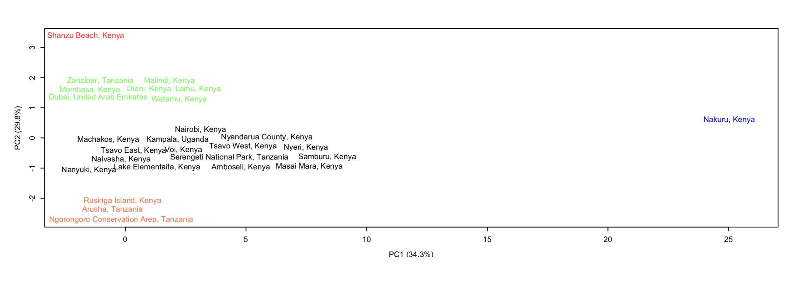
Principal component plot using frequencies of words

Slide 35
Price distributions

Slide 36
Analytics using church data: Easter attendance
Organization question | Raw material (Data) | Data source | Data type
How many services do we need during Easter? | Yes | internal | Structured
Format: Excel
Data type: Structured
Data source: Internal
Observations: 6200
Variables: 2

Slide 37
Sample data

Slide 38
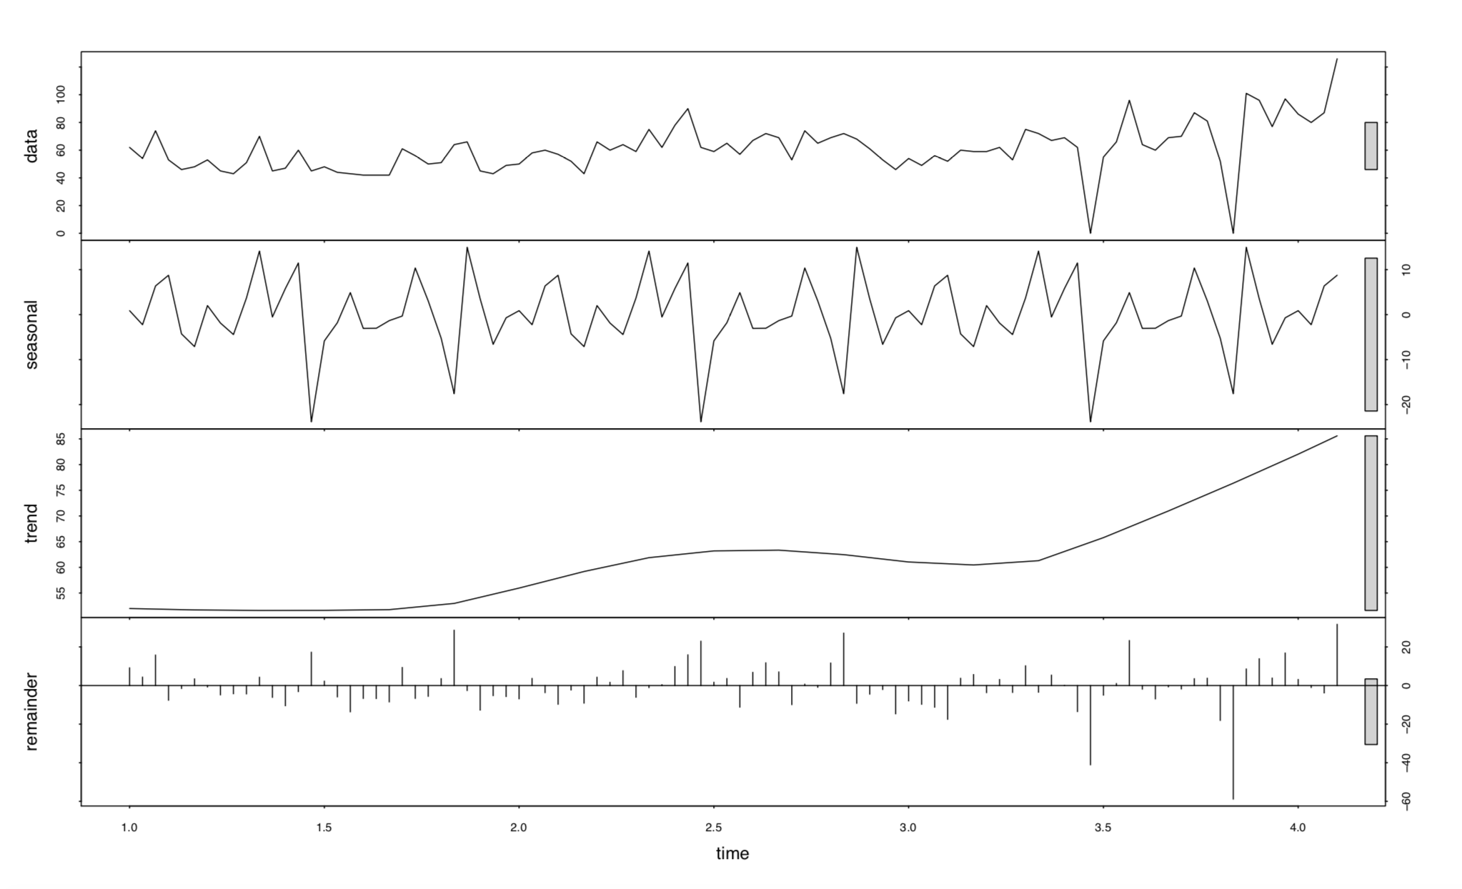
Graphs from Impact City Church

Slide 39
Results
Predicted 798 people plus/minus 30
Range (768 to 828)
Need four services
812 people attended church on Easter Sunday

Slide 40
Acknowledgements
Attendees
Muthoni Wanyoike
Emma Okere
Nairobi Women in Machine Learning and Data Science
Patira Data Science Team

Slide 41
Questions ?????

